Slide 1

Student Performance & Attendance System
A comprehensive database solution tracking academic results and attendance to evaluate student performance and identify support needs.

Slide 2

The Challenge
Identifying At-Risk Students
Performance Trends
Manual tracking makes it difficult to spot students with low attendance or grades early enough for intervention.
Analyzing subject-wise performance patterns requires structured data that manual systems can't provide efficiently.
Actionable Insights
Teachers need data-driven insights to support students effectively and improve educational outcomes.

Slide 3
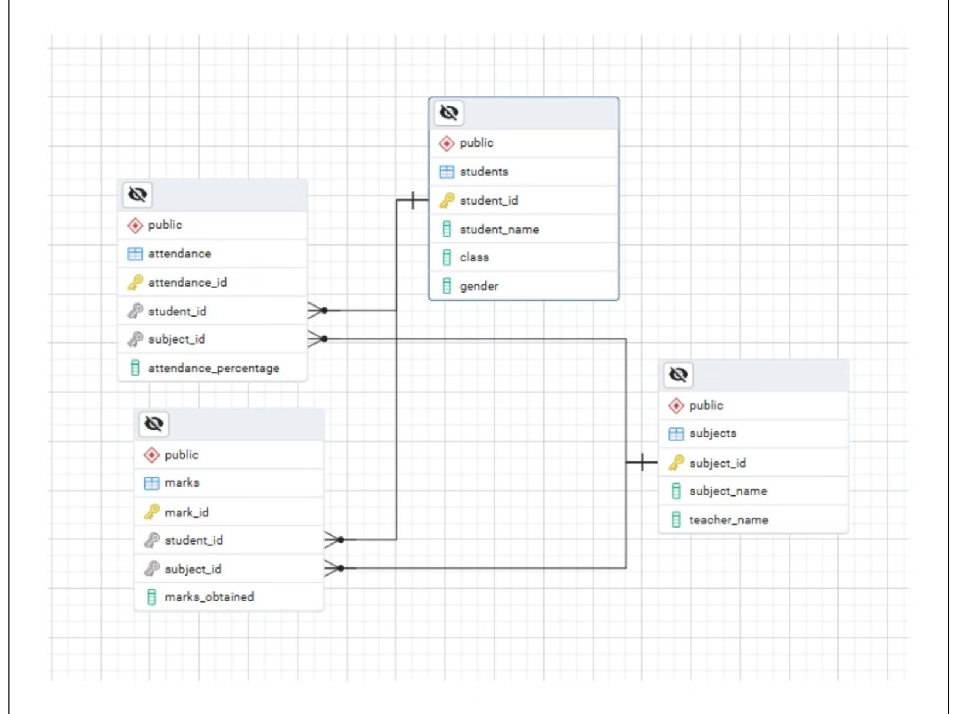
System Architecture
Database Foundation
PostgreSQL powers the system, managed through PgAdmin 4 for robust data handling and analysis.
Core Tables
Students - Personal and class information
Subjects - Course and teacher details
Attendance - Tracking presence per subject
Marks - Academic performance records

Slide 4

Student Roster Overview
10
3
4
Total Students
Class Sections
Core Subjects
Across three class sections
10A, 10B, and 10C
Mathematics, Science, English, Social Studies
The system tracks students like Amit Sharma, Priya Singh, and Rahul Verma across multiple subjects, with dedicated teachers including Mr. Rao (Mathematics), Mrs. Iyer (Science), Mr. Sinha (English), and Ms. Thomas (Social Studies).

Slide 5
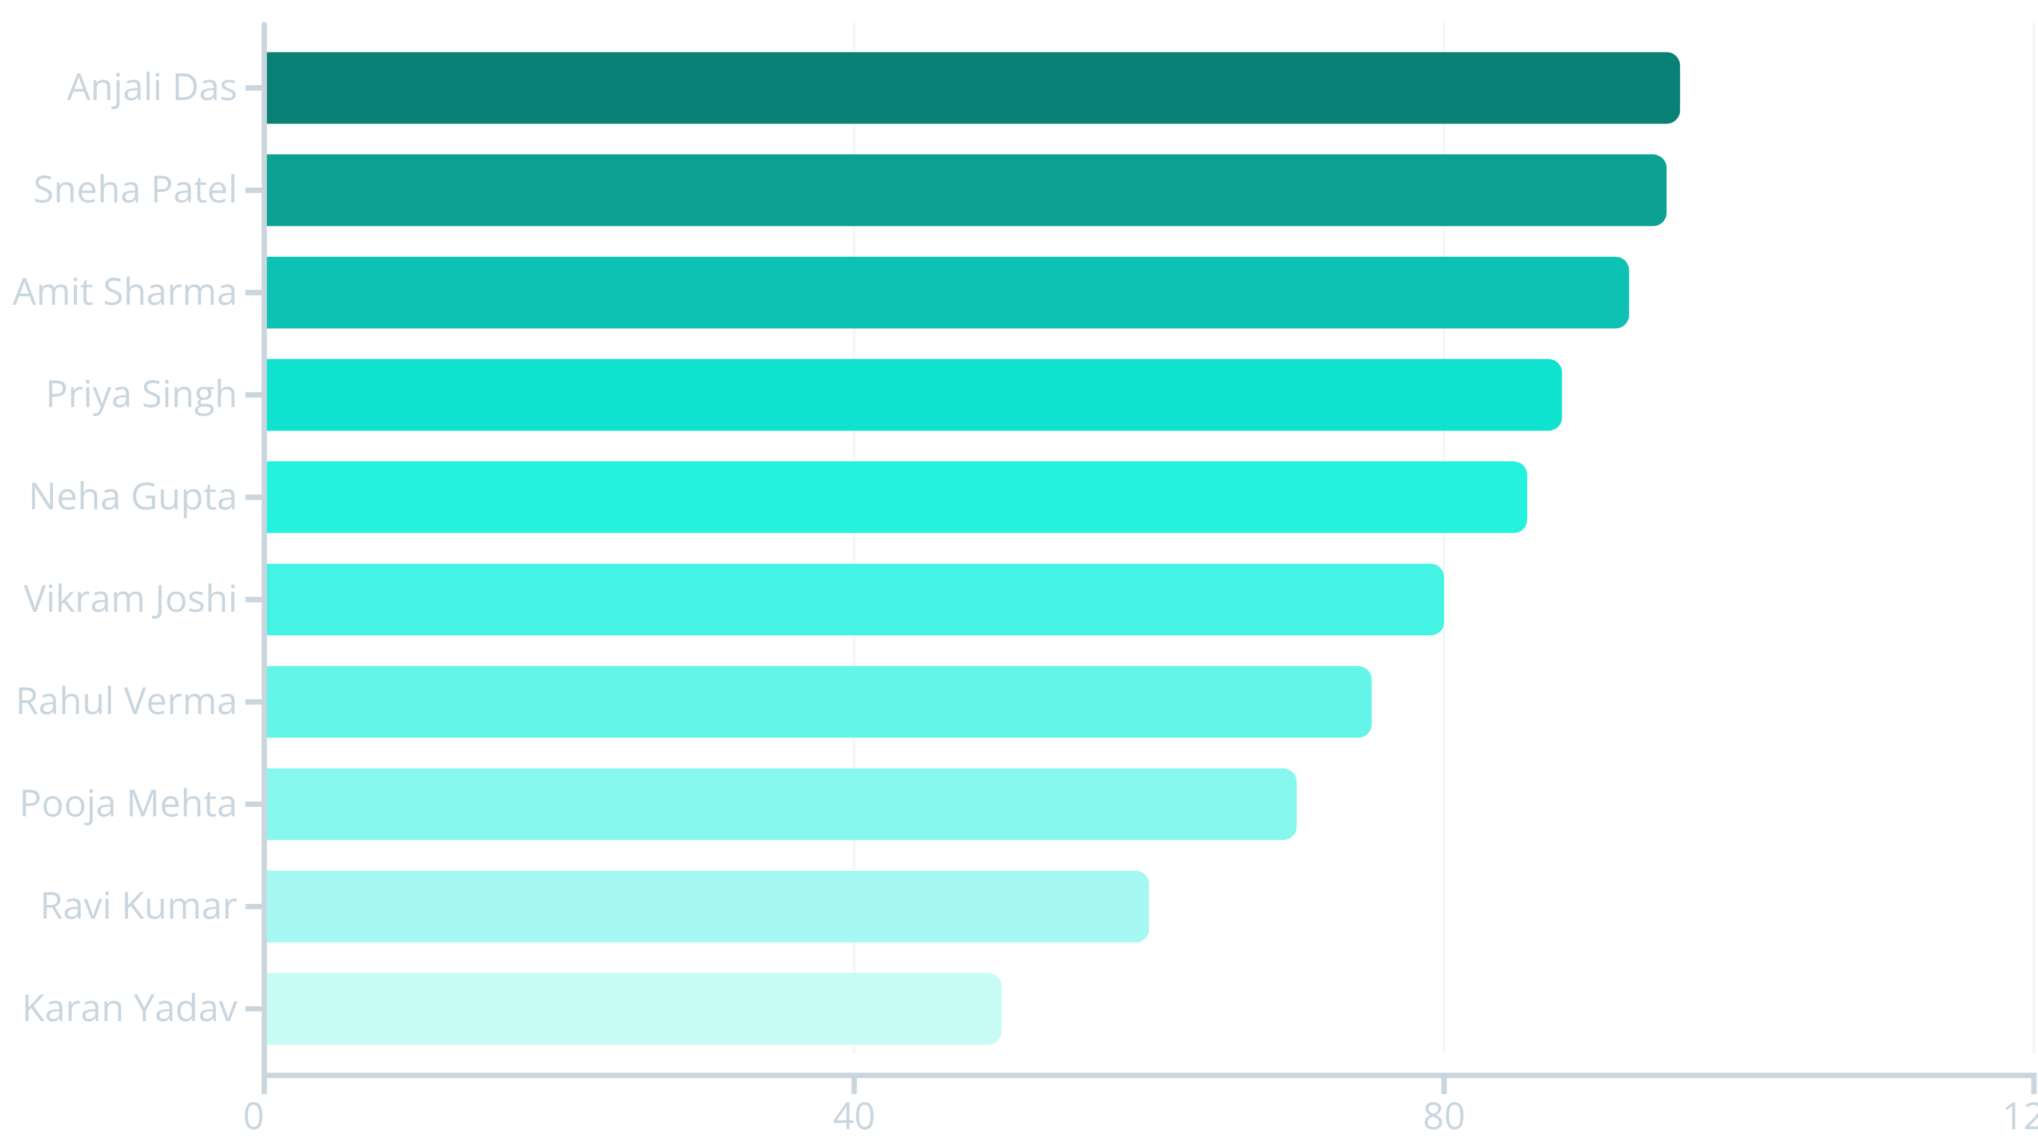

Attendance Patterns
Critical Finding: Two students (Ravi Kumar and Karan Yadav) fall below the 70% attendance threshold, requiring immediate intervention.

Slide 6




The Attendance-Performance Connection
Higher attendance = Higher marks
Top Performers
Anjali Das: 96% attendance, 95 marks
Sneha Patel: 95% attendance, 92 marks
Mid-Range
Vikram Joshi: 80% attendance, 75 marks
Rahul Verma: 75% attendance, 65 marks
At-Risk Students
Ravi Kumar: 60% attendance, 55 marks
Karan Yadav: 50% attendance, 40 marks

Slide 7
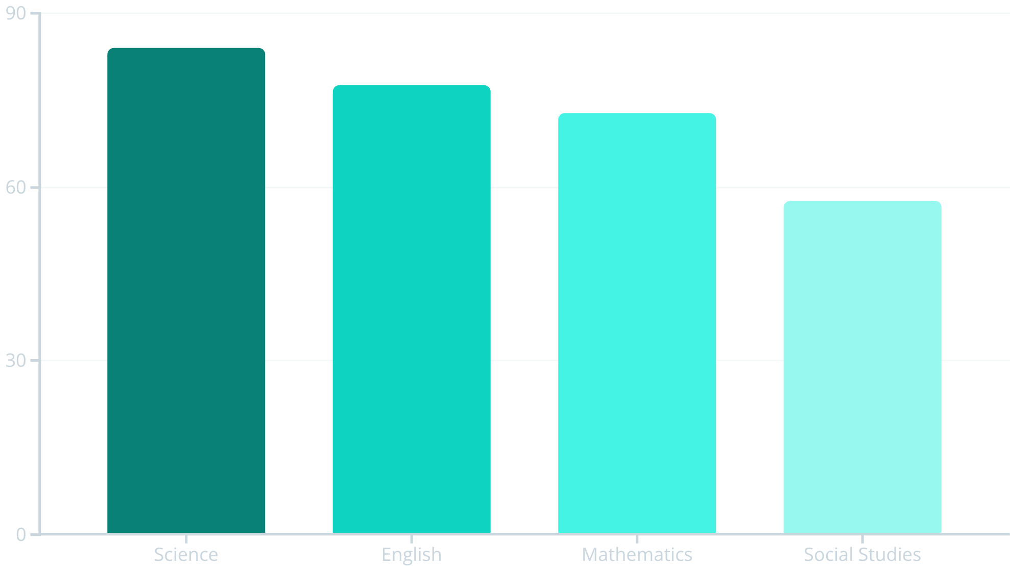
Subject Performance Analysis
Key Insights
Science leads with 84 average marks, indicating strong teaching effectiveness.
Social Studies shows the lowest average at 57.5, suggesting need for curriculum review or additional support.

Slide 8
Student Rankings
01
02
03
Anjali Das
Sneha Patel
Priya Singh
95 total marks
92 total marks
90 total marks
04
05
Amit Sharma
Neha Gupta
88 total marks
80 total marks
Class 10B maintains the highest average attendance at 87.88%, followed by 10A at 77.63% and 10C at 65%.

Slide 9
SWOT Analysis
Strengths
Weaknesses
Efficient tracking of attendance and performance
Depends on data accuracy
Easily scalable system
Manual entry can introduce errors
Supports detailed insights
Opportunities
Threats
Dashboard integration
Data privacy concerns
Machine learning for predicting trends
Security risks if mishandled

Slide 10


Conclusion
The Student Performance & Attendance System successfully demonstrates the strong correlation between attendance and academic achievement.
By providing structured data analysis through PostgreSQL, the system enables educators to:
Identify at-risk students early
Evaluate teaching effectiveness
Make data-driven interventions
Future enhancements with dashboards and predictive analytics will further strengthen educational outcomes.

